Slide 1
Good Morning Students!
Our lesson today is on FRACTION

Slide 2
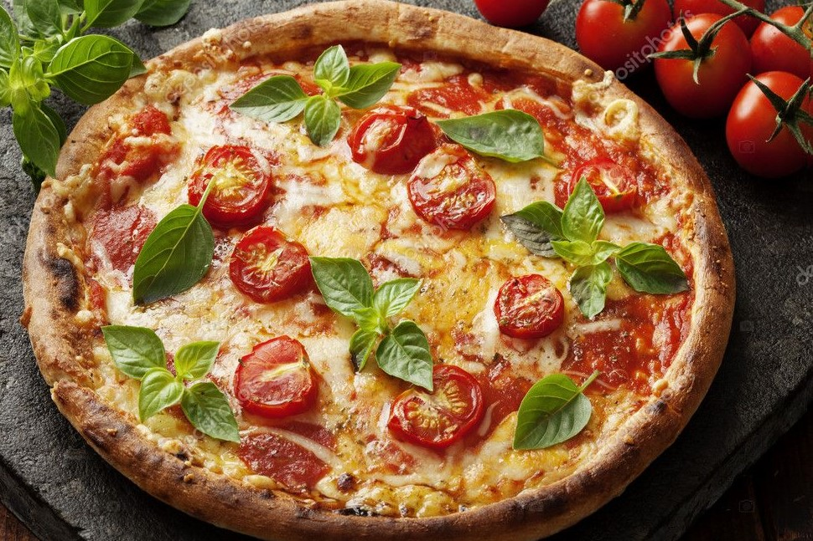
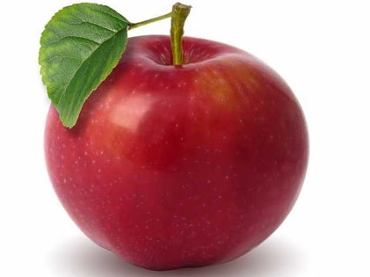
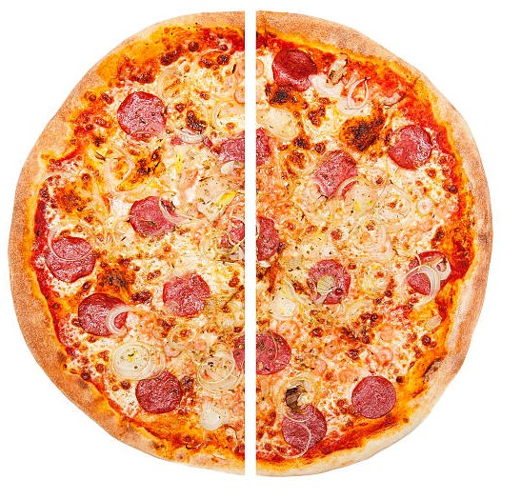
FRACTION
A Fraction is something that shows parts of a whole or equal parts of a whole.
Whole: A complete or a full object is called as a Whole.
Fractions: Fractions are equal parts of a whole.

Slide 3
FRACTION of a Whole Object
One half : A Fraction is called one half when a whole is divided into two equal parts.
One whole Pizza
One half we write as
The bottom of a fraction is called a DENOMINATOR
The top of a fraction is called a NUMERATOR
One half Pizza
One half Pizza
1 2
The top number shows how many parts we are talking about.
The bottom number shows the total number of parts.

Slide 4
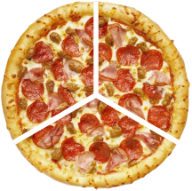
FRACTION of a Whole Object
One - third : A Fraction is called one third when a whole is divided into three equal parts.
One-third we write as
The bottom of a fraction is called a DENOMINATOR.
The top of a fraction is called a NUMERATOR.
One- third pizza
One- third pizza
One whole pizza
One- third pizza
1 3
The top number shows how many parts we are talking about.
The bottom number shows the total number of parts.

Slide 5
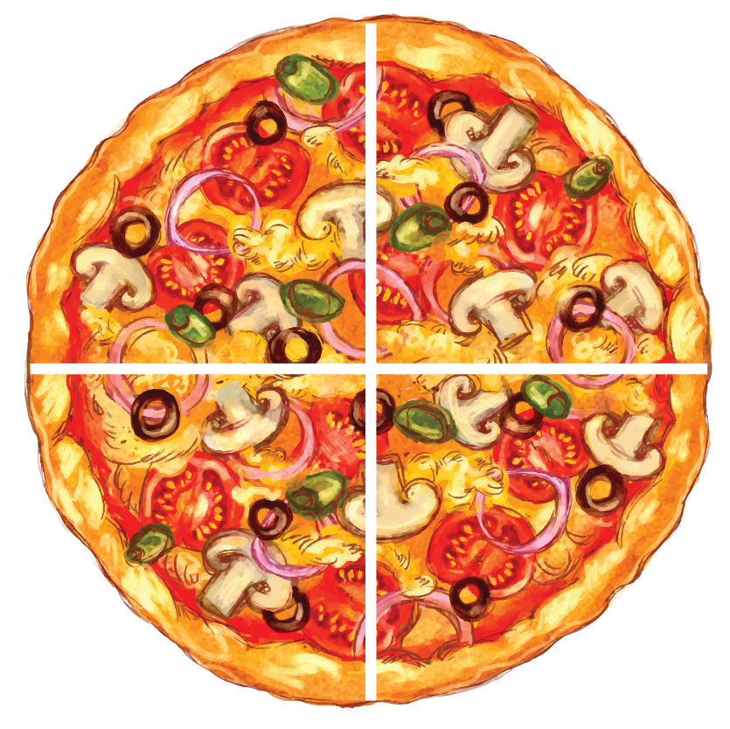
FRACTION of a Whole Object
One - fourth : A Fraction is called one fourth when a whole is divided into four equal parts.
One-fourth we write as
The bottom of a fraction is called a DENOMINATOR.
The top of a fraction is called a NUMERATOR.
One-fourth pizza
One-fourth pizza
One-fourth pizza
One-fourth pizza
One whole pizza
1 4
The top number shows how many parts we are talking about.
The bottom number shows the total number of parts.

Slide 6
LET’S SEE MORE EXAMPLES
Let’s say we have a group of 5 fruits. One is a mango and the other 4 are oranges.
Now let’s figure out : What fraction of the fruits are mangoes?
We know that a fraction has a line in the middle. The top number is Numerator and the bottom number is Denominator.
The Denominator shows the total number of parts or units i.e How many fruits are there? It is 5.
5 is the denominator
The Numerator shows how many parts are there i.e How many mangoes are there? It is 1.
1 is the Numerator
of the fruits are mangoes.
1th 5

Slide 7
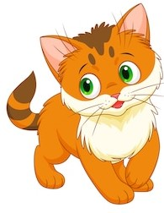
LET’S SEE MORE EXAMPLES
Let’s say we have 5 pets. Two are dogs and the other 3 are cats.
Now let’s figure out : What fraction of the pets are cats?
We know that a fraction has a line in the middle. The top number is Numerator and the bottom number is Denominator.
The Denominator shows the total number of parts or units i.e How many pets are there? It is 5
5 is the denominator
The Numerator shows how many parts are there i.e How many cats are there? It is 3.
3 is the Numerator
So of the pets are cats.
3th 5

Slide 8
Thank you students!

